Slide 1
Project – R
Video Game Sale
By:
Roli Srivastava
Oct 6, 2018

Slide 2


Slide 3
Contents
Overview/Purpose of the study
Methodologies used
Data Description
Insights
References

Slide 4
Overview/Purpose of the study
As a gaming enthusiast, and a newbie data analyst (do you wonder?)
Why a given publisher(Developer) does/does not release games on the platform you own (Xbox, PS3/4, Wii, DS)?
Which geographic region the latest and the greatest games release first, and why?
Who is making the most money? Publisher ? Platform ?
If you were to buy a new gaming console today, what’s the best choice to get the best games, variety/genre?
What type of games people play the most? most famous genre?
Questions? Curiosity? I don’t play games?
I just play games on android/iPhone now? Experience!

Slide 5
Data Descripton
Column Name | Data Type | Description
Rank – primary key | Numeric | Sales rank
Name | String | Name of game
Platform | String | Release platform for the game
Year | String | Year of release
Genre | String | Game genre
Publisher | String | Company which released the game
NA_Sales | Numeric | North American sales
EU_Sales | Numeric | European sales
JP_Sales | Numeric | Japan sales
Other_Sales | Numeric | Sales in other countries
Global_Sales | Numeric | Sales around the worlds

Slide 6
Methodologies used
Descriptive statistics
Correlational matrix studies
Hypothesis Testing
Regression
Tools used: R

Slide 7

Insights

Slide 8
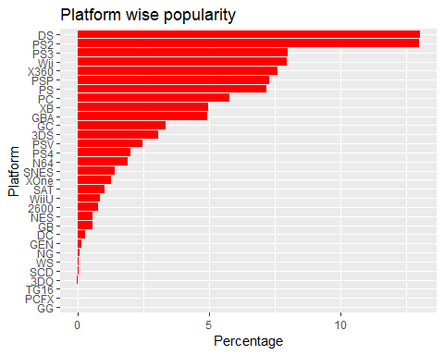
The most popular platform are DS, PS2, PS3, Wii, X360, PSP, PS, PC

Slide 9
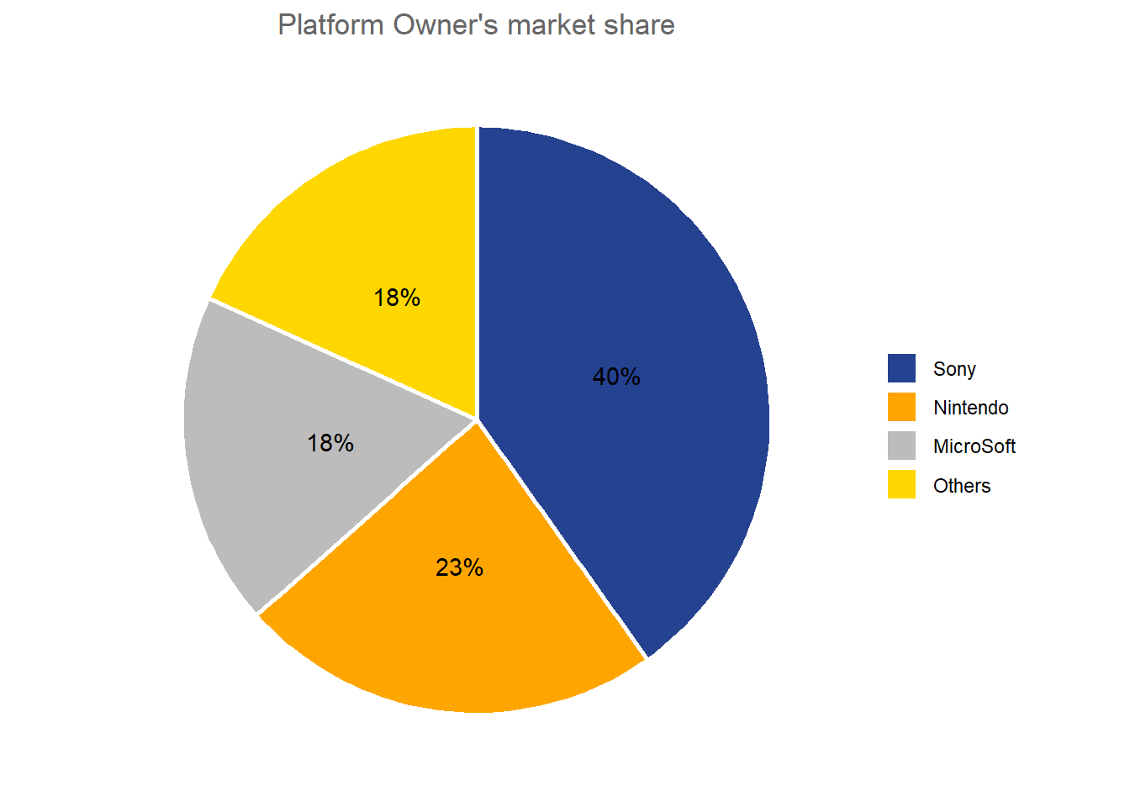
Another perspective on the previous slide!

Slide 10
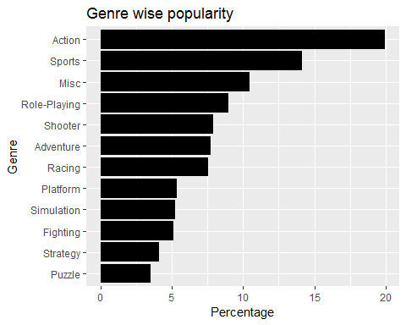
The most popular Genre are Action, Sports, Role-Playing, Shooter, Adventure, Racing (Variety, Consumer perspective!)

Slide 11
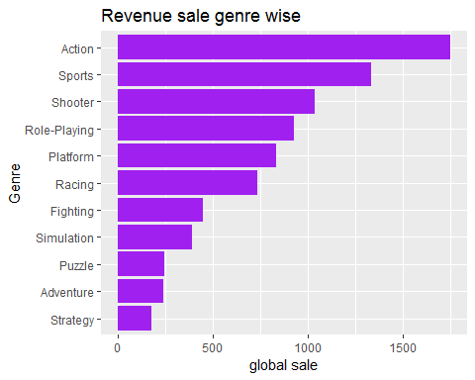
The revenue sale Genre wise is most for Action, Sports, Shooter, Role-Playing, Platform, Racing. (Publisher perspective!)

Slide 12
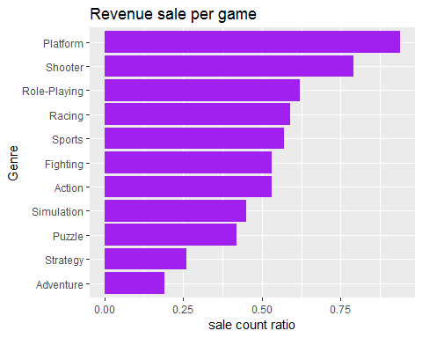
The revenue sale per game Genre wise is most for Platform, Shooter, Role-Playing, Racing, Sports (Game Count / Sales Revenue)

Slide 13
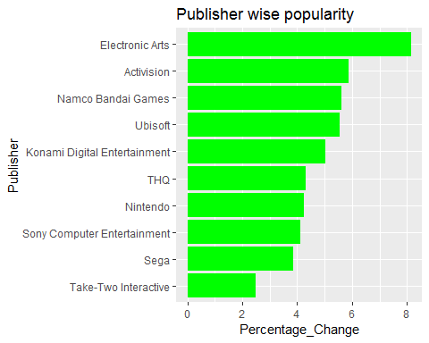
The most popular publisher’s

Slide 14
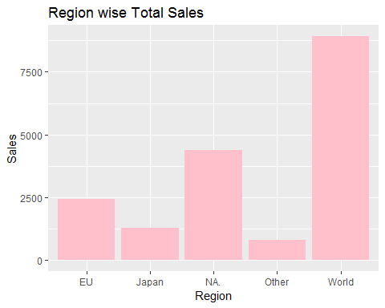
The region wise sale for north America is higher than Europe and Japan for video game sale.

Slide 15
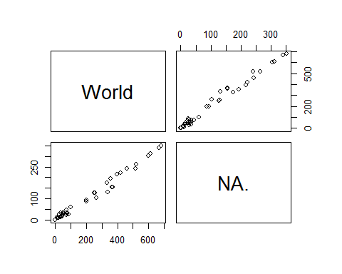
Correlational matrix studies:
positive correlation between NA, EU, JP sale of games vs global sales of game, when NA, EU, JP sale increases so is global sale of games

Slide 16
Hypothesis analysis
Key takeaway: There is a significant relationship b/w Global Sales and Genre
ANOVA test:
Response variable: Global_Sale (numerical)
Explanatory variable: Genre (categorical)
Results (High F value ~ 18.2, Low p-value – 2.2e-16
Outcome: Alternative Hypothesis is Accepted
## H_0: All means are equal. ## H_A: At least one mean is different. ## Analysis of Variance Table ## ## Response: y ## Df Sum Sq Mean Sq F value Pr(>F) ## x 11 479 43.557 18.218 < 2.2e-16 ## Residuals 16586 39654 2.391

Slide 17
Objective : Can we model/predict Sales
Can a publisher predict sales for a given platform in a given geography based on our previous knowledge regarding relationship b/w Genre and Sales?
Model Choice: Multiple Linear Regression Model
Outcome: Not really a reliable model!

Slide 18
Regression analysis
We are assuming the POV of a game’s publisher, who would want to release a game in NA, but does not know which platform and genre to pick.
:
naSalesNoOutlier <- filter(naSales, NA_Sales <= (quantile(naSales$NA_Sales, 0.75) + (1.5 * IQR(naSales$NA_Sales))), NA_Sales >= (quantile(naSales$NA_Sales, 0.25) - (1.5 * IQR(naSales$NA_Sales))))
modelNA <- lm(NA_Sales ~ Platform + Genre, data = naSalesNoOutlier)
summary(modelNA)

Slide 19
Regression cont.
lm(formula = NA_Sales ~ Platform + Genre, data = naSalesNoOutlier)
## Residual standard error: 0.1298 on 14622 degrees of freedom
## Multiple R-squared: 0.131, Adjusted R-squared: 0.1285
## F-statistic: 53.75 on 41 and 14622 DF, p-value: < 2.2e-16
Note also, removing outliers with the 1.5 * IQR rule.
As you can see from the above output that the R-squared values are very low, it means there are other criteria in the world out there which influence and net sales figure in NA. But, there the factor levels and their low p-values, indicate that they legitimately influence the sales.
here’s how we predict a sales value (in million units) for a particular platform and genre (we can add at this point that this is probably not reliable and point to r-squared value):

Slide 20
Sales Prediction Model (STATS)
Region | Degree of Freedom | Residual SE | Multiple R-Squared | Adj R-Squared | F-statistic
EU | 14475 | 6% | 11% | 11% | 42.59
NA | 14875 | 13% | 13% | 13% | 54.53
Japan | 14131 | 2% | 20% | 20% | 86.24
Global | 14663 | 23% | 9% | 9% | 36.14
F-critical = 41, p-value = 2.20E-16

Slide 21
Take away
To make meaningful prediction regarding sales, we should probably try to collect additional data points like
Number of users on each platform in each market
Yearly sales (not just cumulative sales data)
More ?

Slide 22
References
https://core.ac.uk/download/pdf/15035023.pdf
https://scholarworks.umass.edu/cgi/viewcontent.cgi?article=1823&context=theses
https://www.statmethods.net/graphs
https://www.kaggle.com/gregorut/videogamesales
https://www.cnbc.com/2018/07/18/video-game-industry-is-booming-with-continued-revenue.html
https://stat.utexas.edu/videos/r/statistical-inference

Slide 23

Thank you!

